Slide 1
USAID Zambia Evidence For Health (E4H)
PRESENTATION ON COVAX PLATFORM ORIENTATION
Zambia Evidence for Health Project
March 2022

Slide 2
Overview
What is COVAX system
Indicators in COVAX
Live demo
Challenges
Next steps

Slide 3
What is COVAX
The outbreak of COVID-19 did not exclude Zambia, Thus we have received support from donors across the globe this required management.
This led to the introduction the COVAX, this is part of the DHIS2 toolkit for COVID-19 vaccine delivery from the WHO DHIS2 immunization data toolkit, customized by ICT with support from E4H.
The vaccination system was launched on the 14th of April 2021 at the University Teaching Hospital in Lusaka and across facilities country wide.

Slide 4
E4H Support Towards COVAX Development
E4H has shared support throughout the process of the development and stabilization of the COVAX system including the certification system that issues certificate to the public.
The certification system shares the data to the trusted travel database which helps simplify health-related immigration processing for travelers.
As an AU Member States, Zambia also posts vaccination and lab data into the TT validated by Africa CDC.
E4H is helping integrate COVID 19 surveillance instance with COVAX to discontinue duplication and allow a single device to do both tasks.
E4H procured 900 tablets to support covid-19 surveillance and reporting at facility level.
Supported training of SIAs in collaboration with SAFE in Central, Copperbelt and North-Western provinces

Slide 5
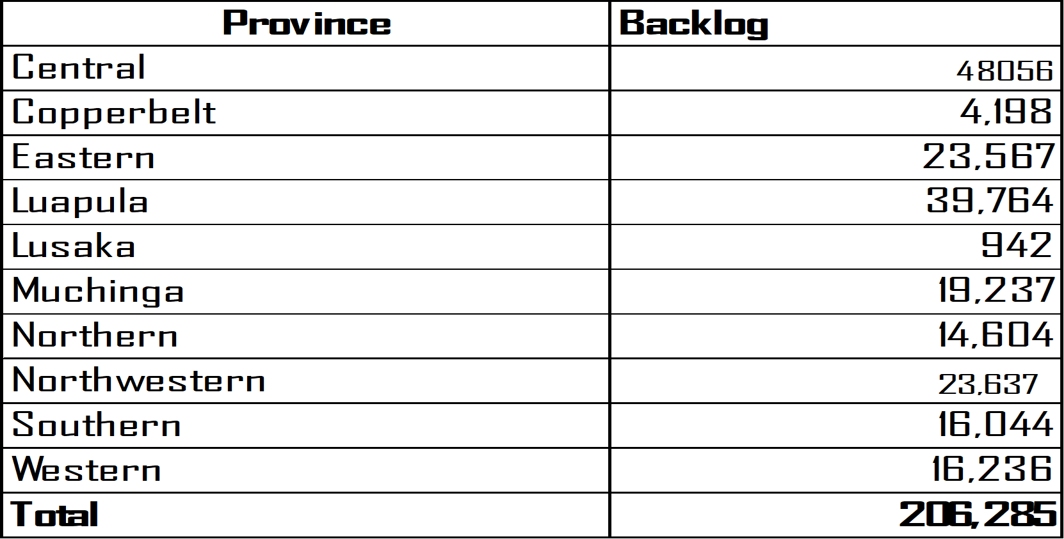
Challenges
Backlog.
Us of March 15th, 2022, the estimated Backlog by Province is at 206,285 across all the Provinces.
2. Inconsistent of captured data – this has put pressure on the certification system when it come to retravel of client certificates.
3. Duplication of work, paper and data entry into the system.
4. Too many different covid 19 apps e.g. hospitalization, lab, covid-19 and COVAX.

Slide 6
Proposed next Steps
Continued support within the supported provinces to help reduce backlog
1. Engage Data entry personnel to clear the backlog in our supported provinces.
2. Possibly help procure more gadgets, and data bundles.
Frequently having routine data cleaning meeting to help correct wrong entries and strengthen validation in the system.
In a long run support the development team with ideas on how to quicken data entry.
Consolidation/integration of the systems from hospitalization, lab, covid19/ EIDSR and COVAX.
Continue to engage MoH to relax the strict rules so that every one can have access to the certification system provided they have received the vaccines.

Slide 7
Thanks!

